Slide 1

Conditional Expressions in Python

Slide 2
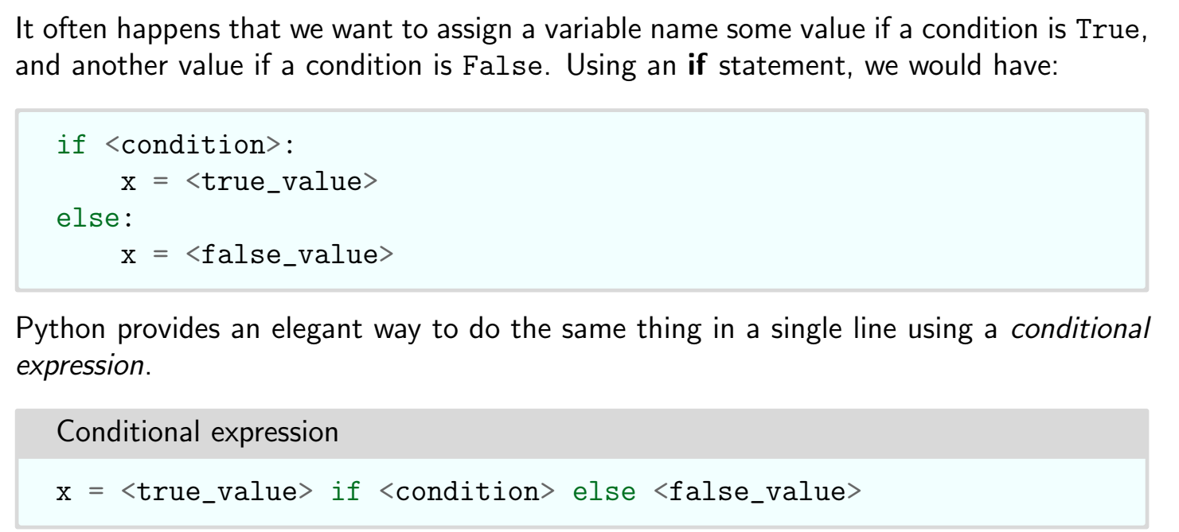
Conditional Expressions

Slide 3
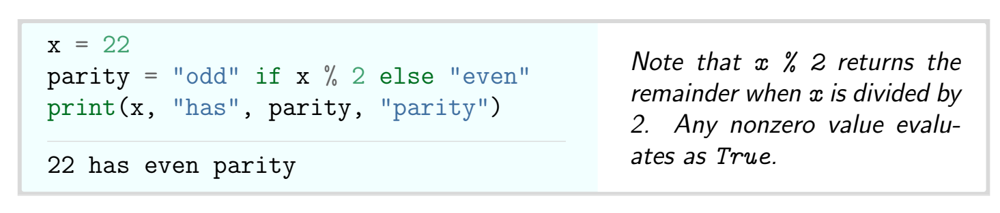
Example

Slide 4
Thank You

